Slide 1
Introductions to Communication Medium
Presented by
Syed Shakil Mahmud
Lecturer
Department of Computer Science and Engineering
Bangladesh Army International University of Science and Technology

Slide 2

Transmission Medium

Slide 3

Transmission Medium
Transmission media can be divided into two broad categories:
  Guided media include twisted-pair cable, coaxial cable, and fiber-optic
  Unguided media is usually air

Slide 4
Guided Media
Guided media, which are those that provide a conduit from one device to another, include twisted-pair cable, coaxial cable, and fiber-optic cable.
A signal traveling along guided media is directed and contained by the physical limits of the medium
Twisted-pair and coaxial cable use metallic (copper) conductors that accept an transport signals in the form of electric current
Optical fiber is a glass cable that accepts and transports signals in the form of light

Slide 5

Twisted-Pair Cable
Consists of
  two conductors (normally copper)
  each with its own plastic insulation
  twisted together

Slide 6
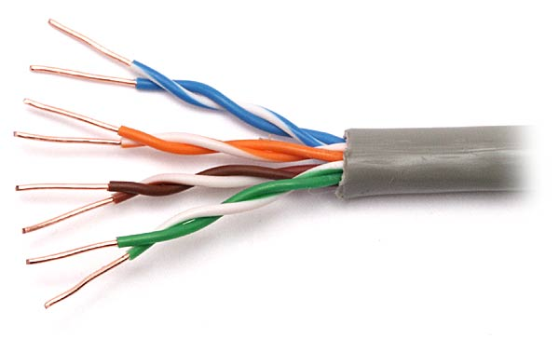
Twisted-Pair Cable
One of the wires is used to carry signals to the receiver
And the other is used as a ground reference
Receiver uses the difference between the two-level
Interference (noise) and crosstalk may affect both wires and create unwanted signals
The number of twists per unit of the length (e.g. inch) determines the quality of the cable
  More twists mean better quality

Slide 7

Unshielded versus Shielded
Two common twisted-pair cable used in communications
  Unshielded twisted-pair (UTP)
  Shielded twisted-pair (STP)
STP has a metal foil or braided-mesh covering
  Preventing the penetration of noise or crosstalk
  It is bulkier and more expensive

Slide 8

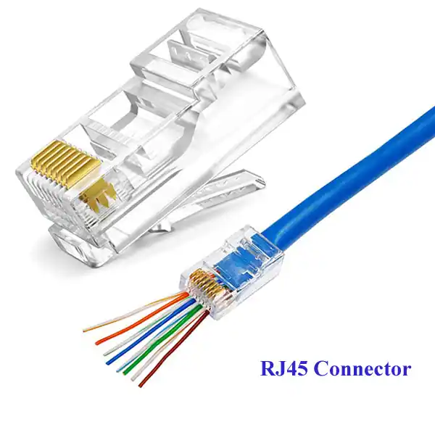
Connectors
The most common UTP connector is RJ45
  R J stands for Registered Jack

Slide 9
Applications
Used in telephone Lines (UTP)
DSL lines (UTP)
Local area networks

Slide 10
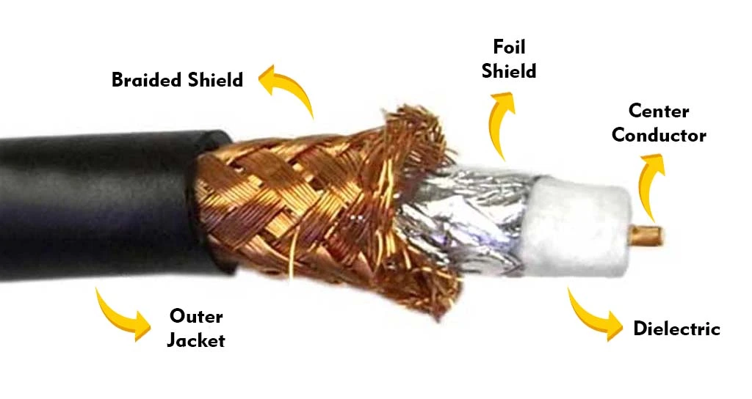
Coaxial Cable

Slide 11
Coaxial Cable
Carries signals of higher frequency ranges than twisted-pair cable
Coax has a central core conductor of solid or stranded wire (usually copper)
Encased in an outer conductor of metal foil, braid, or a combination of the two
The outer metallic wrapping services as:
  Shield against noise
  Second conductor (completes the circuit)
Outer conductor is also enclosed in an insulating sheath
Whole cable is protected by a plastic cover

Slide 12
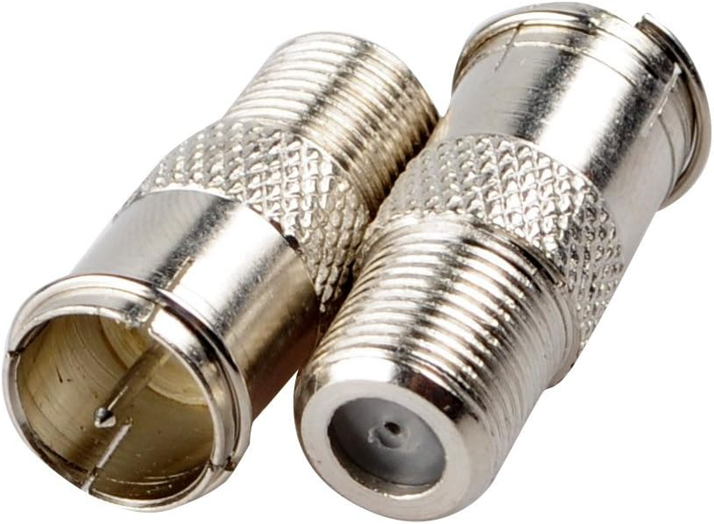

Coaxial Cable Connectors
Coaxial cable connector is BNC (Bayone-Neill-Concelman)
Figure shows the BNC connector, the BNC T connector, and the BNC terminator

Slide 13
Applications
It was used in analog and digital telephone networks (replaced by fiber-optic)
Cable TV networks (replaced by fiber-optic)
Traditional Ethernet LANs

Slide 14
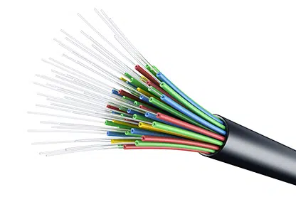
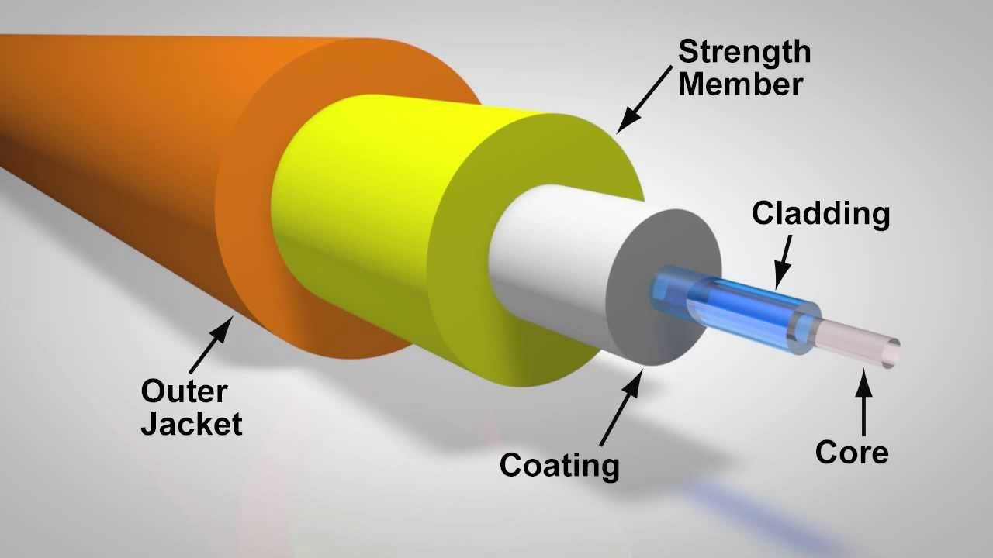
Fiber-Optic Cable

Slide 15

Fiber-Optic Cable

Slide 16

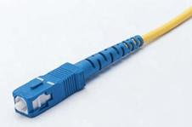
Fiber-Optic Connector
Fiber-optic use three different type of connectors
  Subscriber Channel (SC) connector
    Used in cable TV and it uses a push/pull locking system
  The Straight-Tip (ST) connector
    Used for connecting cable to networking devices
  MT-RJ in new connector with the same size as RJ45

Slide 17
Fiber-Optic Connections
Applications
It used in backbone networks
For cable TV with coaxial cable (a hybrid network)

Slide 18
Advantages of Optical Fiber
Advantages over twisted-pair and coaxial
    Higher bandwidth
    Less signal attenuation
      Signal with fiber-optic can run for 50 km with requiring regeneration
      5 km for coaxial or twisted-pair cable
    Immunity to electromagnetic interference
      Electromagnetic noise cannot affect fiber-optic cables
    Resistance to corrosive materials
      Glass is more resistant to corrosive materials than copper
    Light weight
    More immune to tapping
      Fiber-optic cables definitely more immune to tapping than copper cables

Slide 19
Disadvantages of Optical Fiber
Disadvantages
  Installation/maintenance
    Because it is new technology, need expertise
  Unidirectional
    If we need bidirectional we need two fibers
  Cost
    The cables and interfaces are expensive

Slide 20

UNGUIDED MEDIA: WIRELESS
Wireless transmission can be divided into:
  Radio waves
  Microwaves
  Infrared waves

Slide 21
UNGUIDED MEDIA: WIRELESS
Radio waves
  Radio waves: waves range in frequencies between 3 KHz and 1 GHz
  Microwaves: waves ranging in frequencies between 1 and 300 GHz
  Radio waves are omnidirectional (propagated in all directions)
  The sending and receiving antennas do not have to be aligned
  Useful for multicasting: Radio, television. Cordless phones and paging system

Slide 22
UNGUIDED MEDIA: WIRELESS
Microwaves
  Microwaves are unidirectional
  Antenna need to be aligned
  Advantage: pair of antenna can be aligned without interfering with another pair
  Microwave propagation is line-of-sight
  For long distance communication
    Very tall towers
    Repeater
  Very high-frequency microwaves cannot penetrate walls
    Disadvantage if receiver inside a building

Slide 23
UNGUIDED MEDIA: WIRELESS
Applications
  Due to unidirectional properties, microwaves are useful when unicasting (one-to-one) communication
    Cellular phones
    Satellite networks
    Wireless LANs

Slide 24
UNGUIDED MEDIA: WIRELESS
Infrared
  From 300 GHz to 400 THz (wavelengths from 1 mm to 770 nm)
  Use for short-range communication
  It has high frequency, cannot penetrate walls
    Prevents interference between one system and another
      Remote control not interfere with our neighbors
  Can not be used outside because sun’s rays contain infrared waves (interference)
  (IrDA) Infrared Data Association established standards for communicating between devices:
    Keyboards, mice, PCs and printers

